Slide 1
Welcome to Euclid Ave UMC in Oak Park, Illinois
Notes:
This series is about what other churches are doing. Let’s start with one UMC in the Chicago area. It’s a big building nearly the size of West End, but with many fewer people. Nevertheless, they are making a big impact on their community and the planet.
Note the signage
In the background: Jesus was radically inclusive
The red sign: Hate has no home here.
And my favorite, the green one:
This congregation is powered by solar, geothermal, and God’s love!

Slide 2
“Don't it always seem to go That you don't know what you've got til it’s gone They paved paradise And put up a parking lot.” —Joni Mitchell
Notes:
Not so at Euclid Avenue. They ripped up their parking lot and installed geothermal heating for their facility.
When they repaved their parking lot, the only things that were gone were fossil fuel and thousands of dollars of heating bills.

Slide 3
Geothermal installations bring in warmth and cooling from the earth.
Notes:
This is the heat pump that controls the movement of the energy.
Geothermal is exceptionally efficient and uses no fossil fuels, but with the size of the church, more was needed.

Slide 4
100 solar panels added on the roof
Notes:
The church went after grants to round out their big energy needs.
All their electricity, heating, and cooling are now powered by the earth and sun.
The dollars saved can go into ministry—not building maintenance.

Slide 5
The rain garden captures water and lets it soak naturally into the earth.
Notes:
Even the pavers on the path are porous.
Not only is this garden, including the pavers, good for the earth, but it is also a welcoming space.
Newcomers get a sense of beauty and of a congregation that cares about creation.
Members feel a sense of peace—and pride for what they are doing for the earth.

Slide 6
No emissions here!
Notes:
People are encouraged to come to church.
They are also encouraged to do so without emissions!
Having the bike racks makes it more possible and likely.

Slide 7
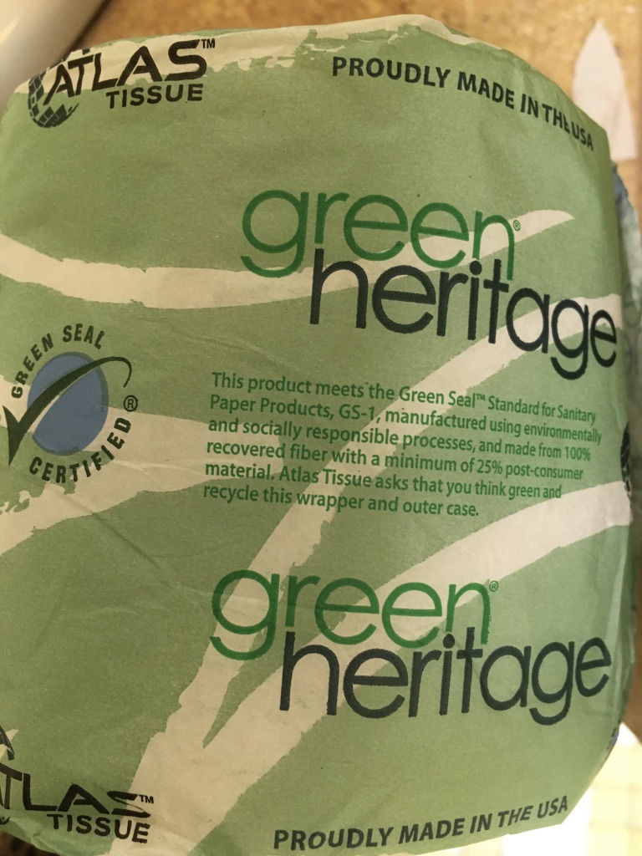
“Little things” count!
Notes:
Seemingly small choices are important. The toilet tissue is Green Seal Certified!
It is manufactured using environmentally and socially responsible processes from 100% recovered fiber– even the wrapper, which you will notice is not plastic!

Slide 8
Make a choice!
Make it easy!
Notes:
Appropriate bins are in strategic locations around the church.
With their presence and clear labeling, the bins themselves educate and encourage everyone to participate.

Slide 9
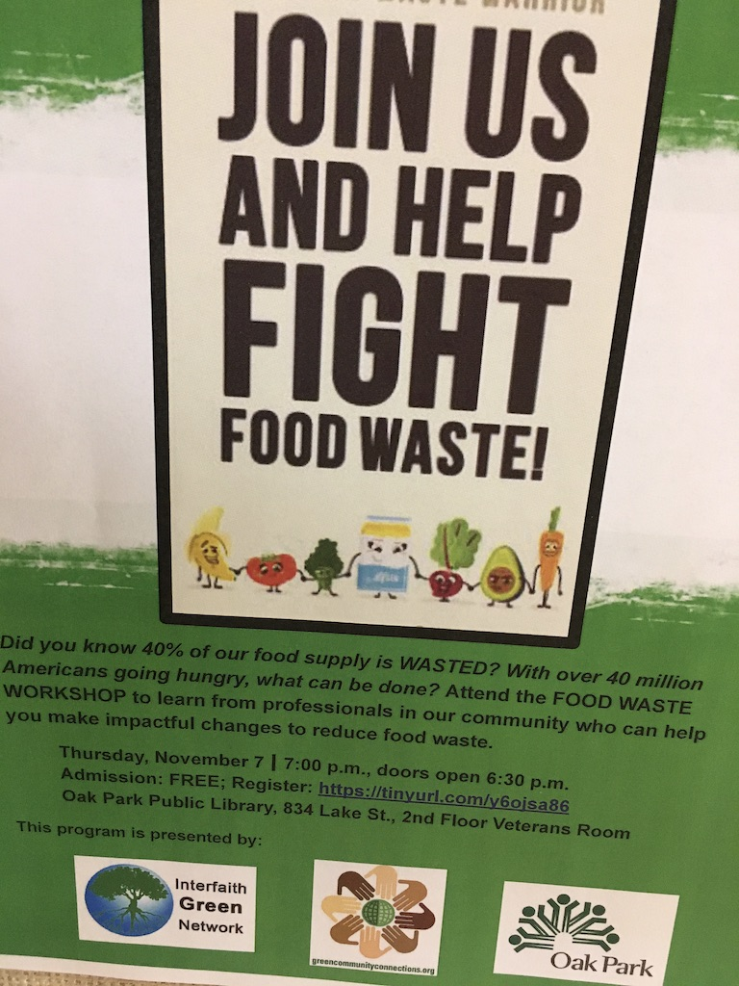
Individuals AND Community
Notes:
The church continually educates and invites people to do their part.
But notice the signs at the bottom: This church is also a catalyst and participant in the community’s efforts. They are making a difference beyond the church walls.

Slide 10
Speaking up!
Notes:
As an advocate within the community, the church has been instrumental in getting the word out and moving others beyond words to action.

Slide 11
Eco-Friendly Christmas Ideas
Notes:
Beyond Euclid Avenue UMC, other churches are also doing what they can. This “home grown” display from Collegiate UMC in Ames, Iowa, is just one example of the ways church members have taken up the mantle of raising awareness and encouraging others to think beyond the presents they might give or get.
They are reminding us all of the real gift we have—this Earth. It is a gift from God and our gift in return is to love it and take care of it!

Slide 12
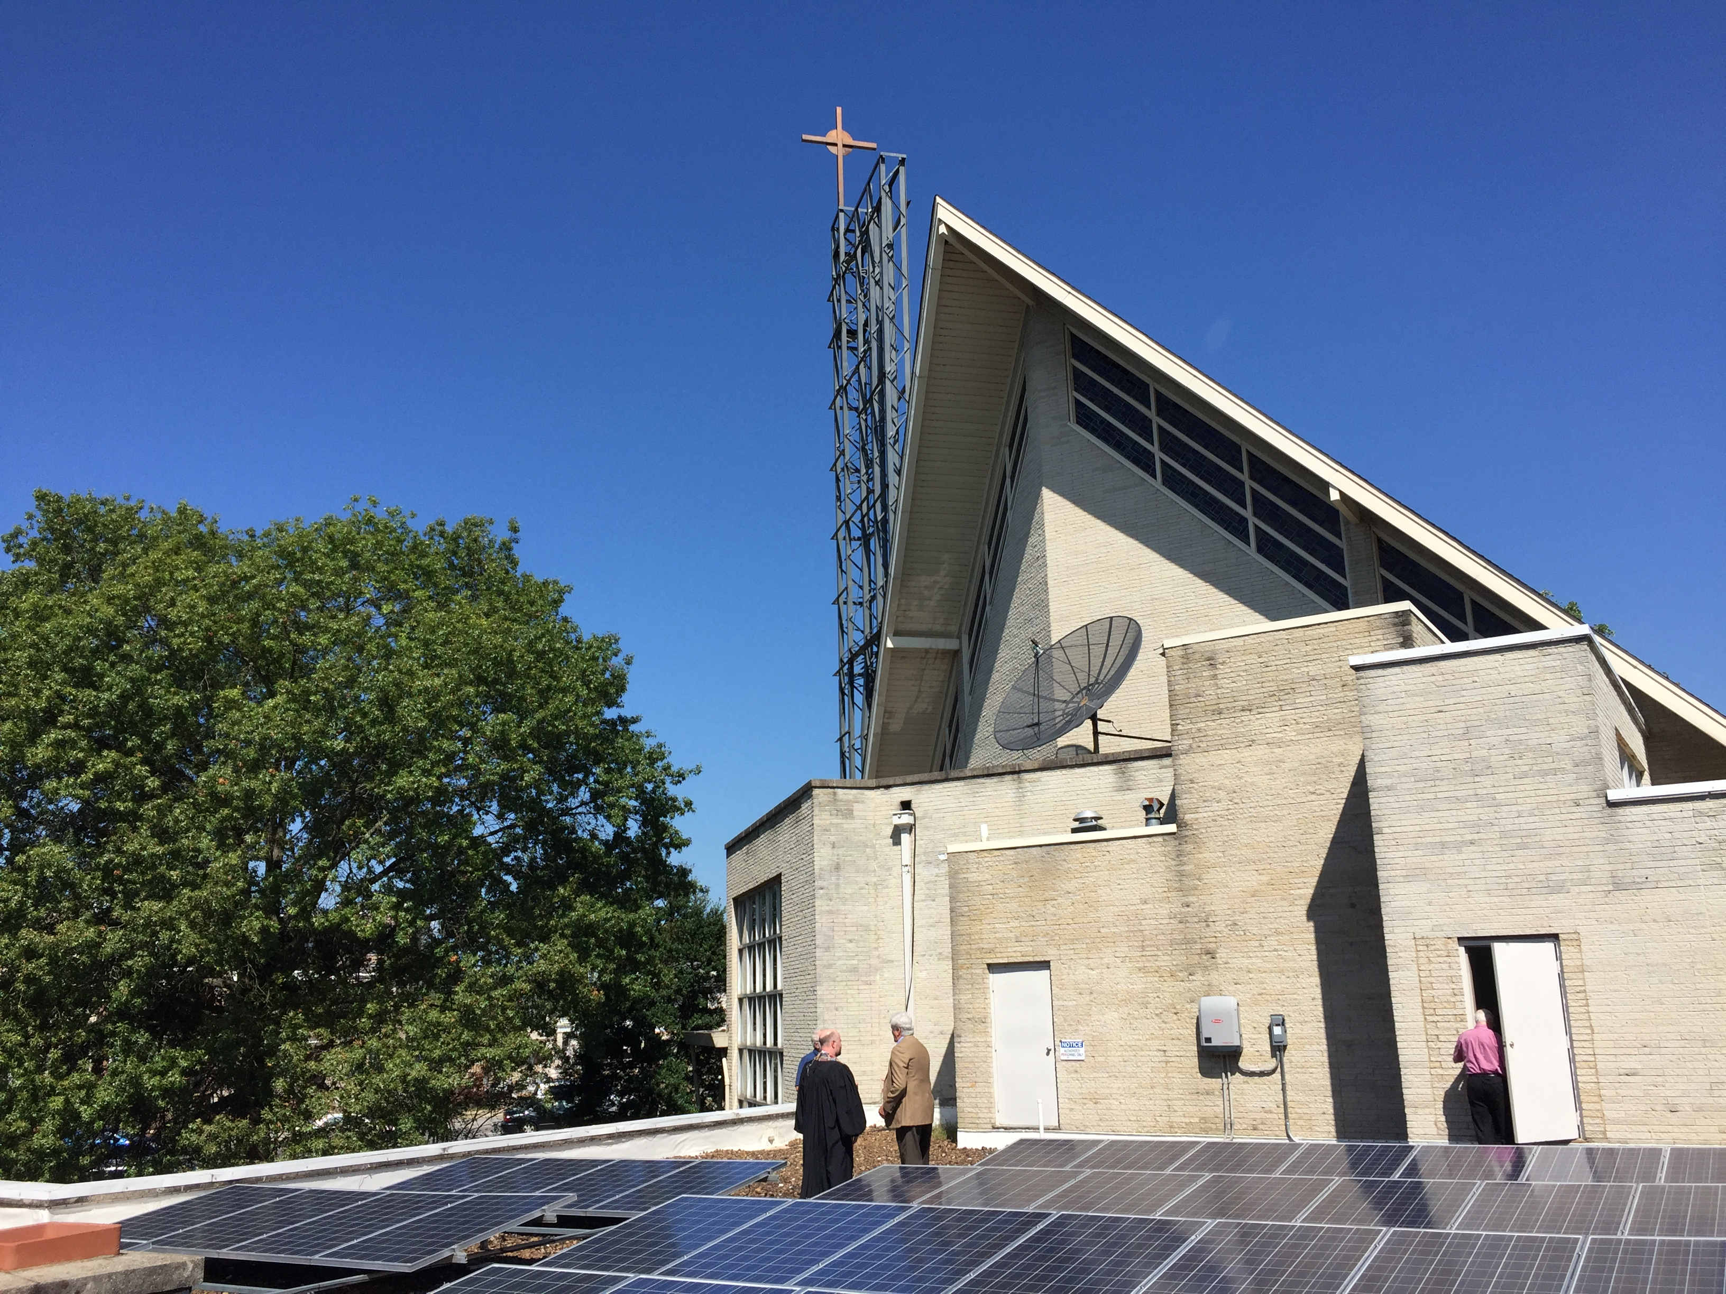
Closer to Home
Solar Panels
Blakemore
&
Christ UMC
Notes:
A number of churches in the Nashville area, including West End, are working on Creation Care and environmental justice.
Blakemore UMC, and Christ, have added solar panels to their roof, which saves both emissions and dollars.
Christ UMC has also changed their lighting to LED, saving the equivalent of 50 tons of carbon dioxide not polluting the air—and $12,000 annually. West End has also taken that step.

Slide 13
Collaborating
Recycle Day
Notes:
Being a connectional church, United Methodists often work together. The annual Recycle Day in West End's parking lot is a project of multiple congregations. We just happen to have a great asset in our location and facility.
By collaborating with other UMC's and also through the Tennessee Interfaith Power and Light organization, we are able to do much more for our earth.

Slide 14
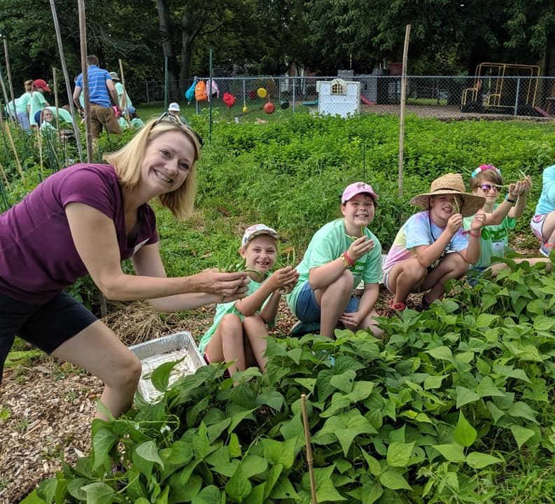
Using Our Assets
Whatever they are!
Notes:
You may recognize some of these West Enders! In 2019 the 4th–6th graders in their Mission Week helped pick vegetables at South End UMC’s garden. South End has a different asset—a large, sunny front lawn. Now, as a garden, it provides food during the summer for 20+ families, who were identified by the nearby schools as food insecure. They come each week for a great meal, Christian fellowship, and a large box of fresh produce.
Franklin First also has their “Giving Garden.” They raised 30,000 pounds of organic vegetables, cut flowers, and herbs in one year on their five acres.
The two churches welcome volunteers to help in the gardens. UPDATE RE COVID.

Slide 15
Repairing Land and Waterway
BEFORE
Hillcrest UMC 2015
1750 feet of stream frontage on a branch of Mill Creek
Almost half an acre
1 day of planting
75 volunteers
Notes:
Hillcrest UMC was blessed with land and a vision. With a flood-prone Mill Creek tributary running through the property, they saw a need to repair the land and the waterway.
With trees! They did the planning and spread the vision. 75 volunteers showed up, some of them from other UM churches.

Slide 16
400 Trees Later
AFTER
3 years later
50 pounds of CO₂ removed annually per tree
Decreased storm runoff
Improved water quality
Improved ecosystem health
Notes:
400 trees and 3 years later the area is flourishing. They have improved water quality and ecosystem health, and they the are removing 50 pounds of CO2 annually per tree. How many pounds is that? 20,000!
Like all the other ways we’ve looked at, planting trees is helpful, but the need to offset carbon is even greater. We need people like you and me to do more. Working together!

Slide 17
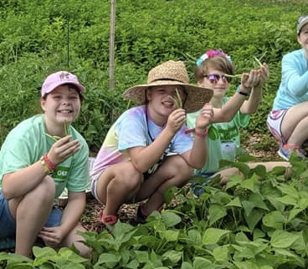
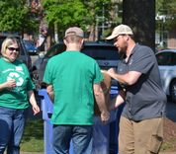
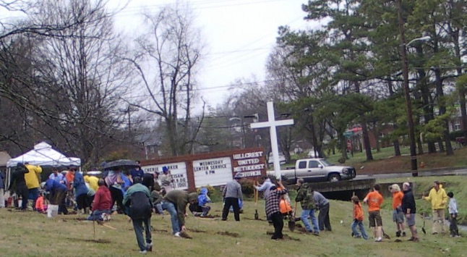
We are not alone!
Notes:
We’ve seen multiple ways various churches have made creation care a priority, given the assets they have.
I hope also that you have seen that our UM connection is another asset. Through it we can widen our opportunities to have a greater impact in Creation Care and environmental justice. Supporting one another through sharing information, funding, and volunteering are all possibilities. We are are not alone.
Thanks be to God!

Slide 18
Education Advocacy Practice/Stewardship
Notes:
For the last 18 months our Creation Care Committee has been working in these three areas. In terms of education, we’ve been learning ourselves with the help of other UM entities: 6 of us attended the UM Creation Care Summit; 2 of us continue working at the national level on projects that have come out of that Summit. 2 more of us are now official UM EarthKeepers following our training by UM Global Ministries. At least 4 of us have been involved in Tennessee Interfaith Power and Light organization. One of us serves on the Tennessee Conference Creation Care Team.
In advocacy, we’ve been active in educating our own congregation as well. We had the Wednesday Night series in February and March, our Earth Day videos, and now our SS class programs are starting.
We’ve written a resolution for West End and took that to the Tennessee Conference group, who then subsequently has written one that will, if adopted, give guidance to all the conference churches. We’re also involved with climate justice issues legislatively and through lobbying on Capitiol Hill.
In the area of practice, we’ve gotten approval from the Trustees to set up recycling and composting bins in the church when we return. Our Recycling Day had to be postponed as did the Plant Sale, but those are both past practices and we trust future ones too.
These are a smattering of what we’ve been doing.

Slide 19
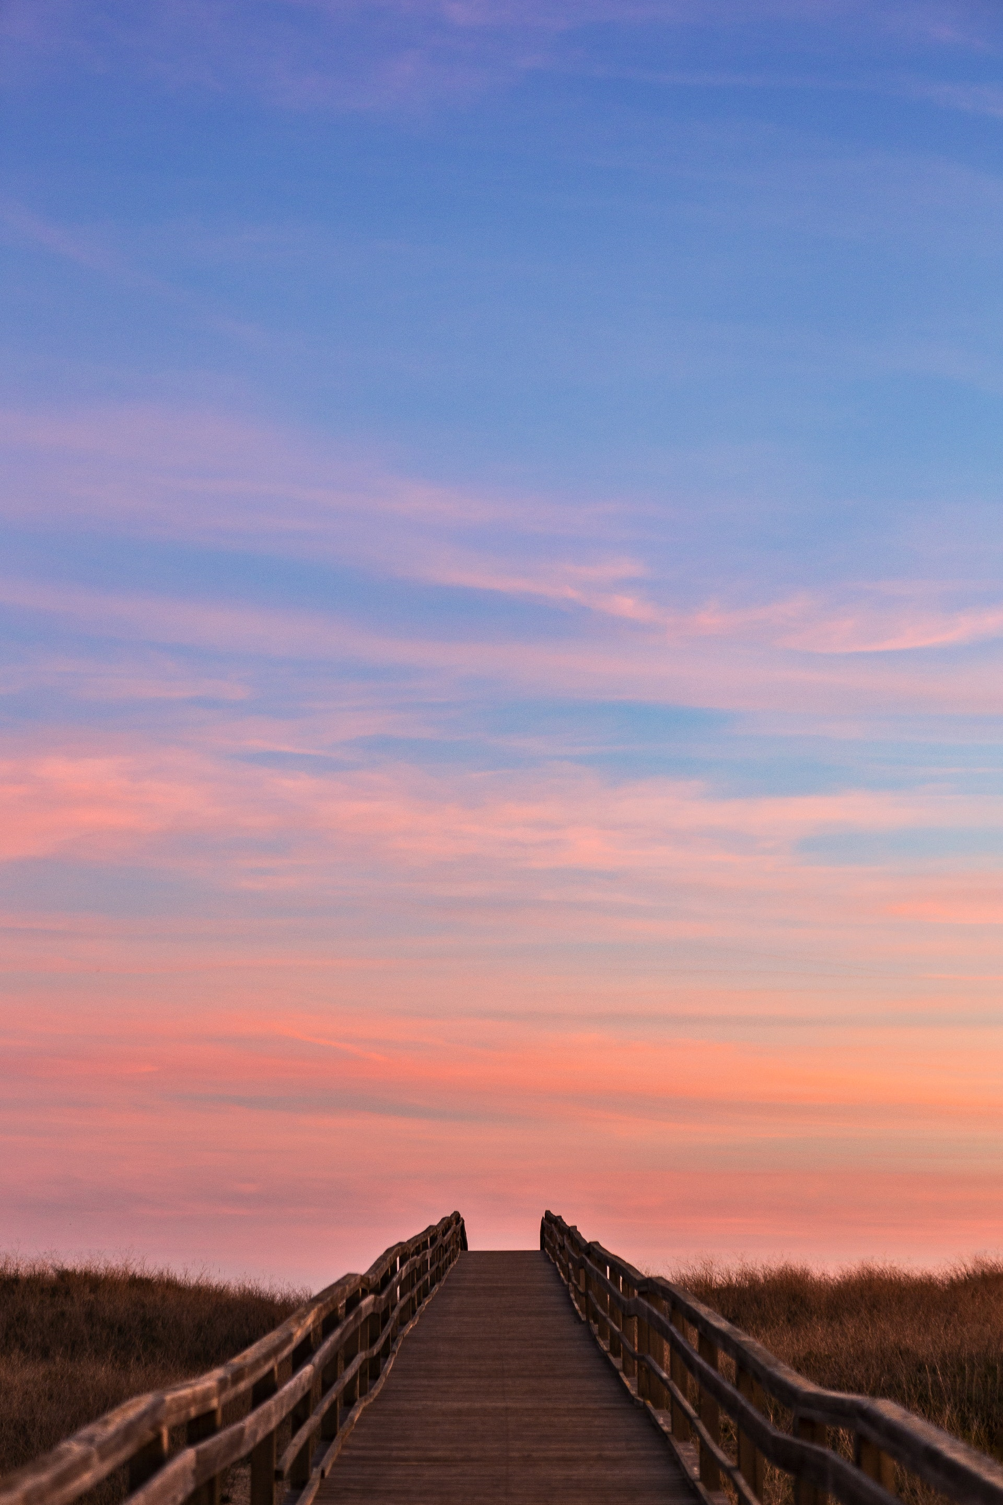
Your Turn!
What of these ideas please you?
What possibilities excite you?
What ideas do you think West End should investigate further?
Notes:
What you saw, what you heard,
Other experiences, other ideas

