Slide 2
Dan Joranko
TN Interfaith Power & Light
United Methodist Creation Care
Vanderbilt University
Michael Black
United Methodist EarthKeeper
Georgia State University
Matthew Groves
TN Interfaith Power & Light
Young Evangelicals for Climate Action

Slide 3
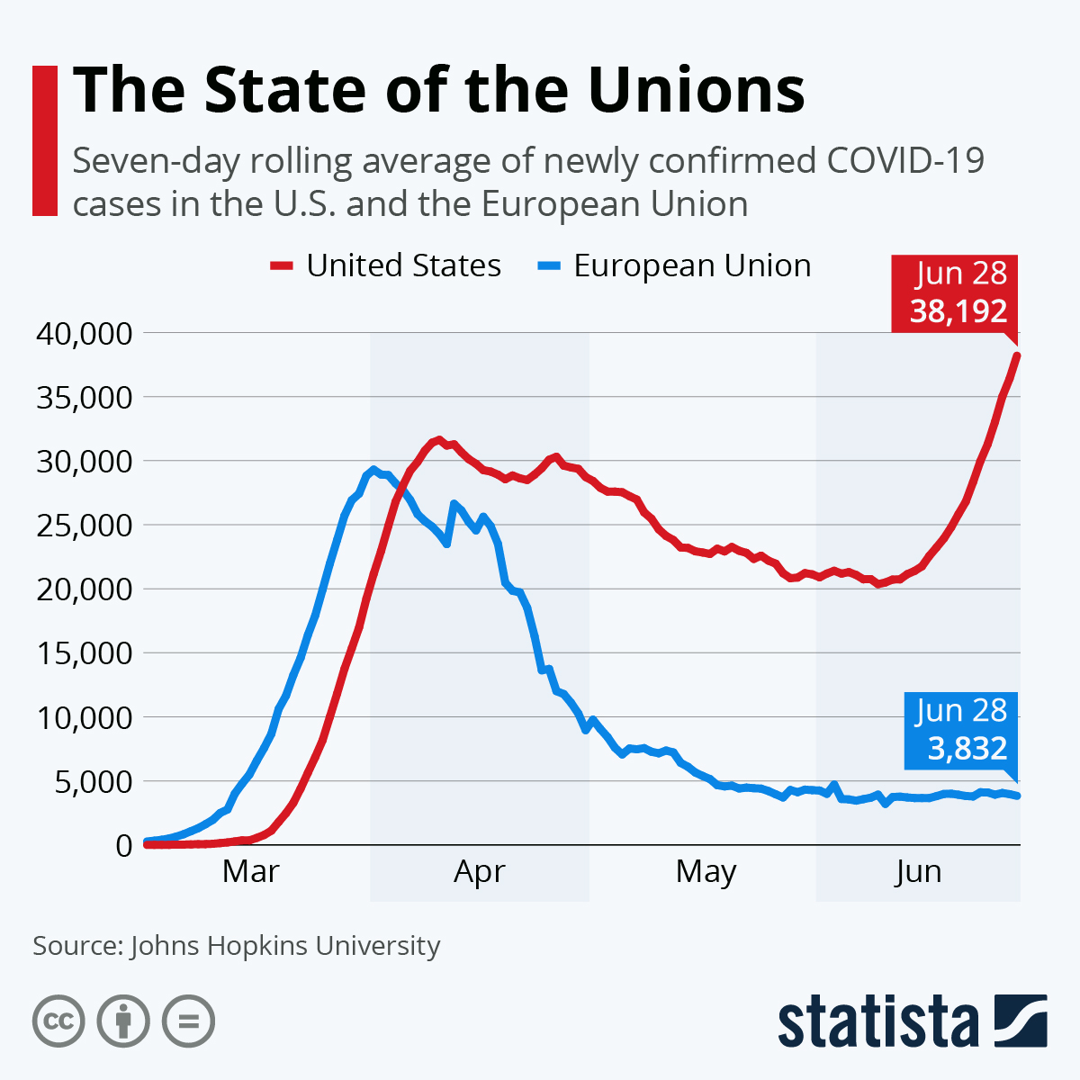
US population: 328m
EU population: 446m
On July 17th:
US newly confirmed tops 70,600!
US Cases of Covid
EU cases of Covid

Slide 4
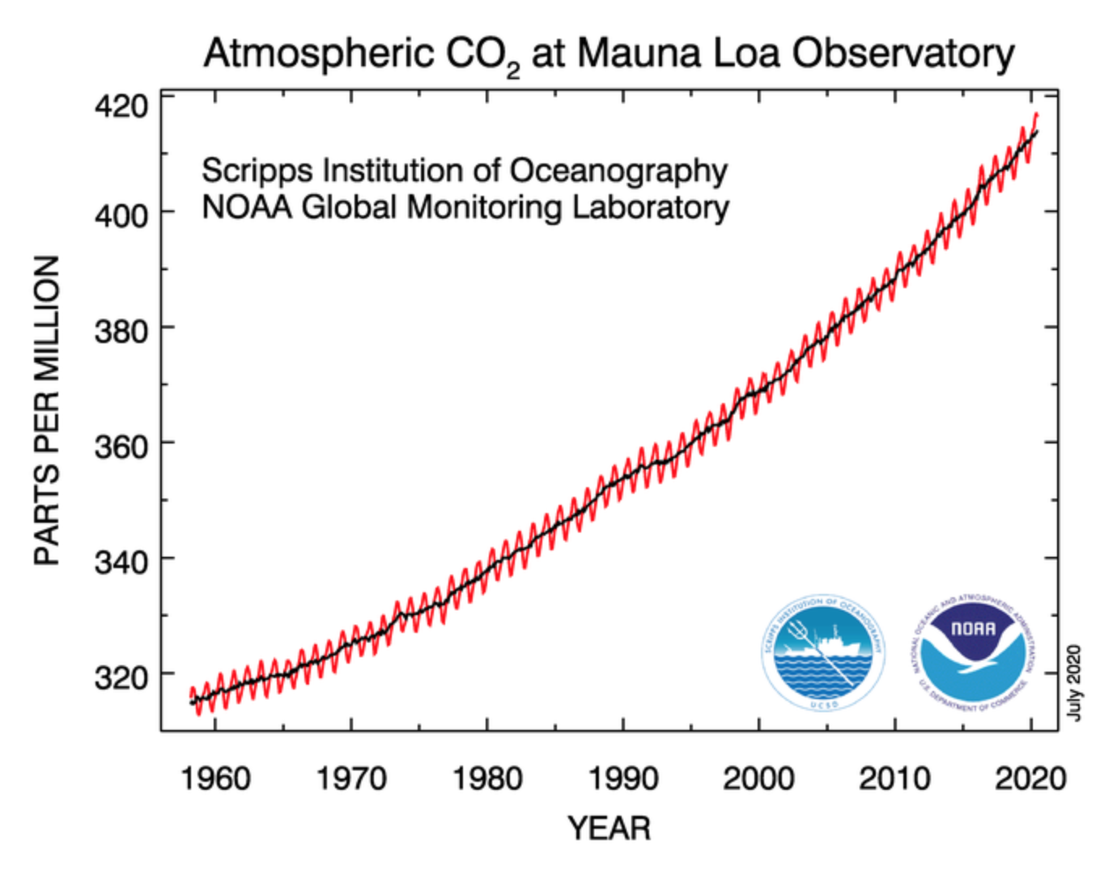

Slide 5
1
Listen to the Science

Slide 6
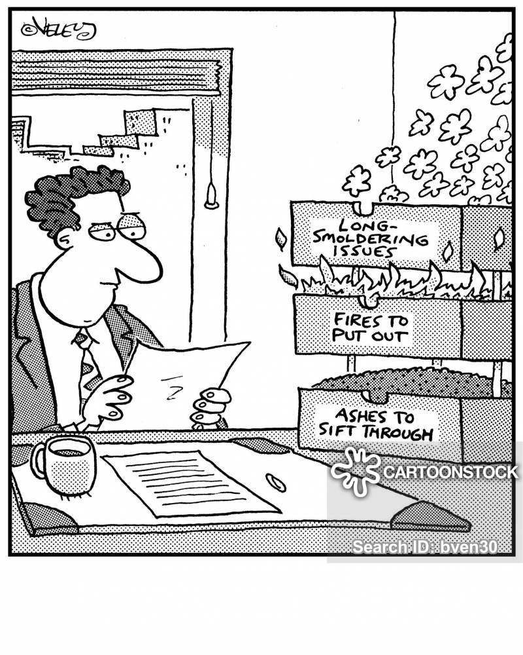
2
Act Early and Decisively in the face of a crisis

Slide 7
3
Competent public institutions are critical

Slide 8
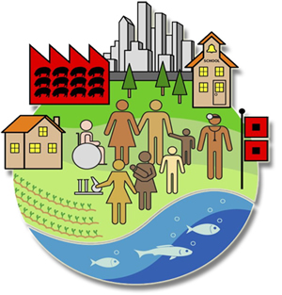
4
The environment plays a key role in health and impact

Slide 9
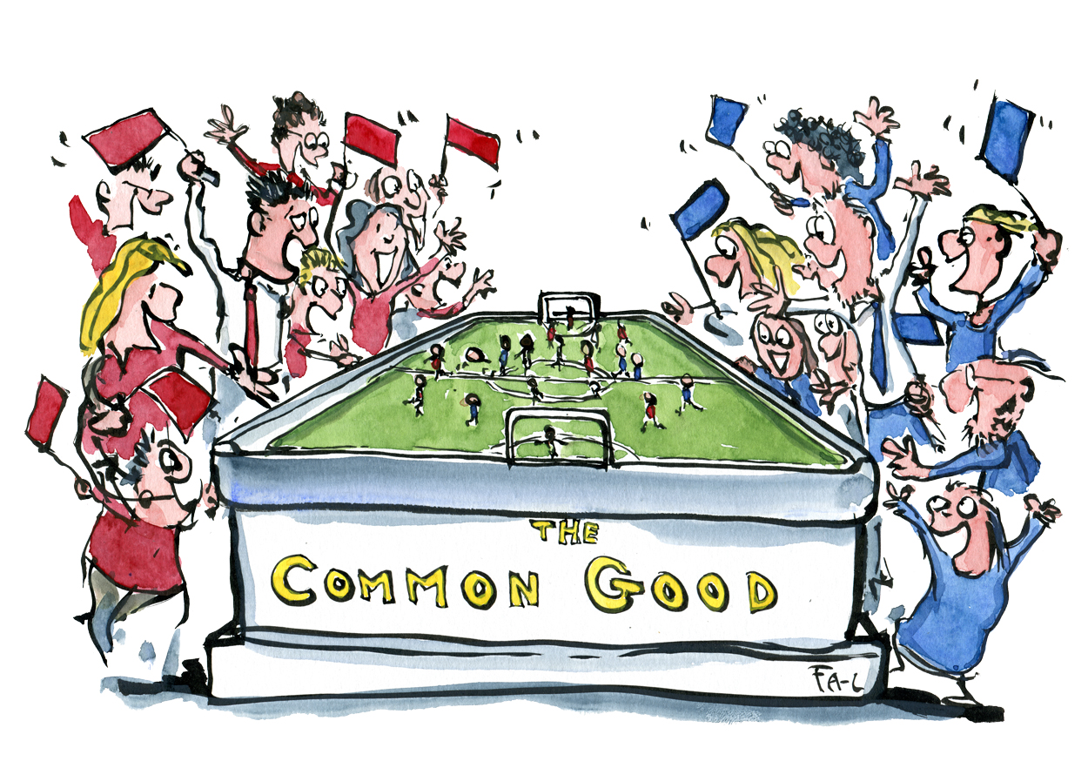
5
Protecting the common good transcends ideology and partisanship

Slide 10
6
International cooperation is essential

Slide 11
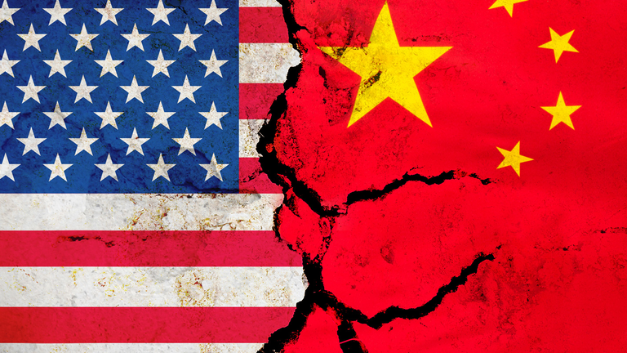
7
The United States (and China) play
central roles

Slide 12
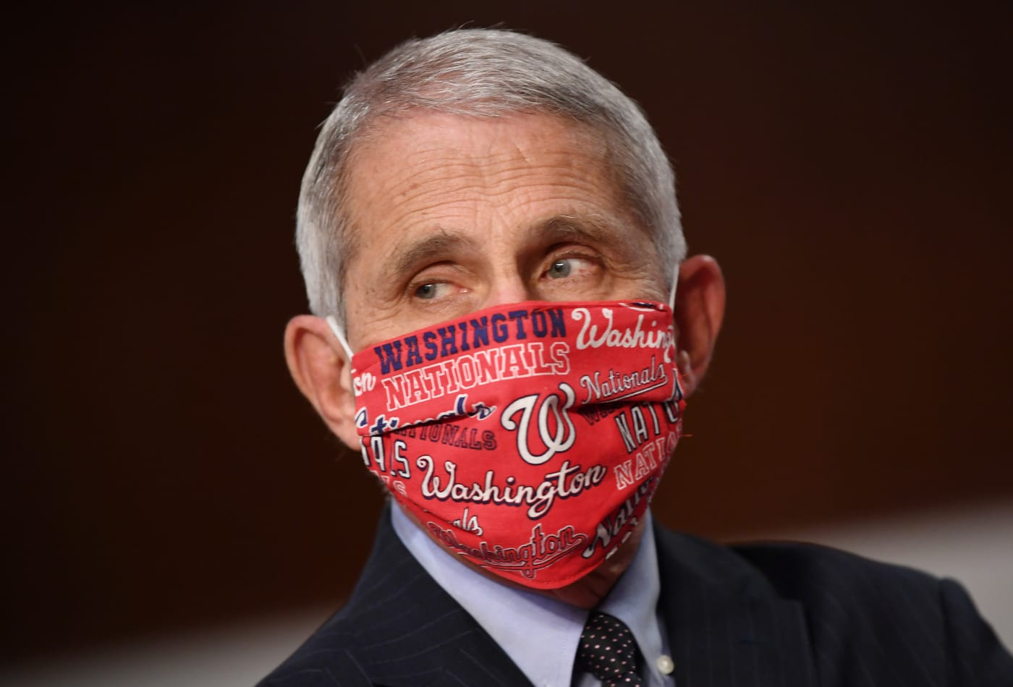
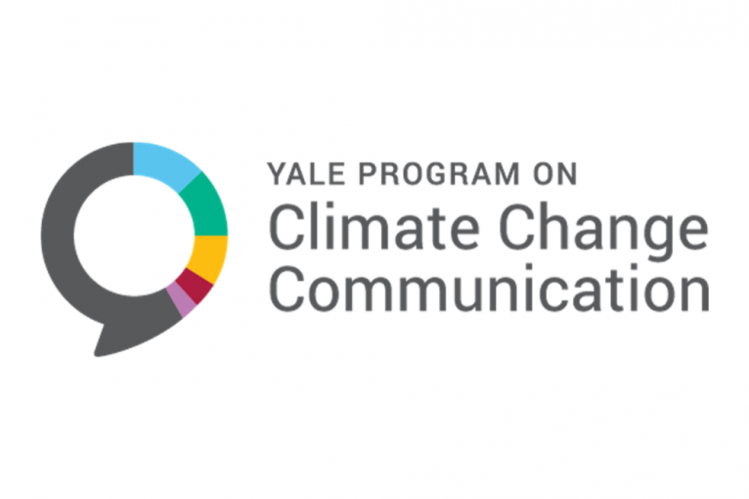
8
Clear and consistent communication
is crucial

Slide 13
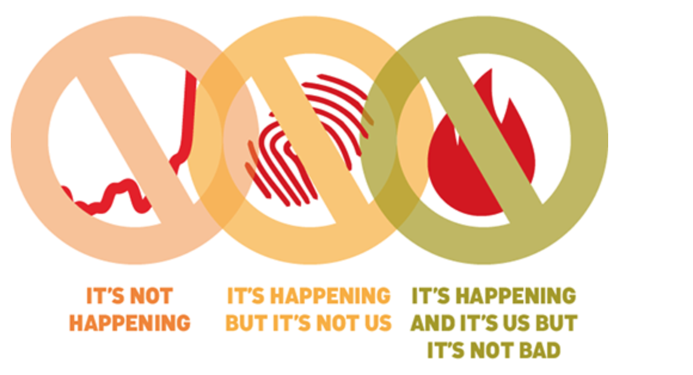
9
Denial can take on varied forms
and dimensions

Slide 14
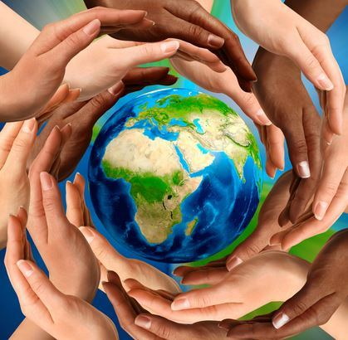
10
We are all in this together…

Slide 15
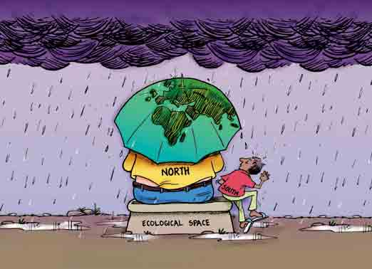
11
… but some are more vulnerable
than others

Slide 16
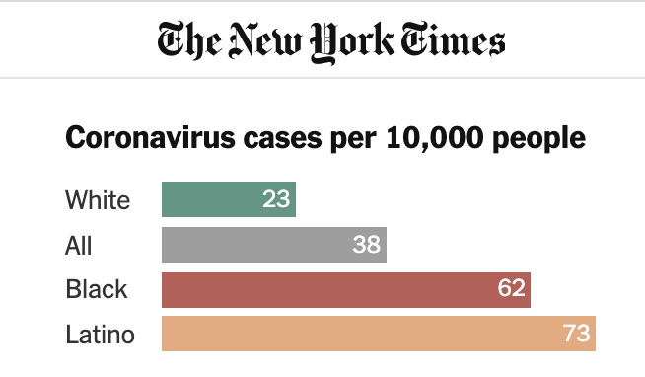
11
The Fullest Look Yet at the Racial Inequity of Coronavirus, New York Times, 7/5/2020.

Slide 17
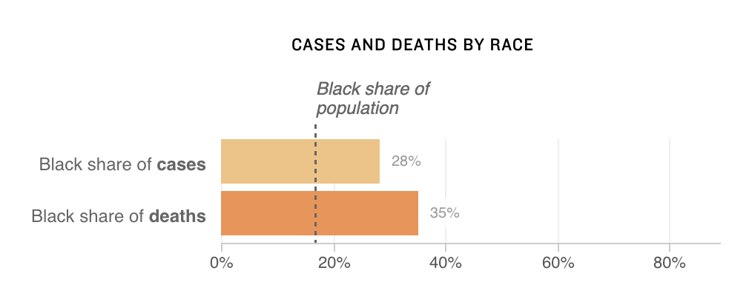
11
What Do Coronavirus Racial Disparities Look Like State By State?, NPR, 5/30/2020.

Slide 18
12
We have the capacity to cooperate for the common good

Slide 19
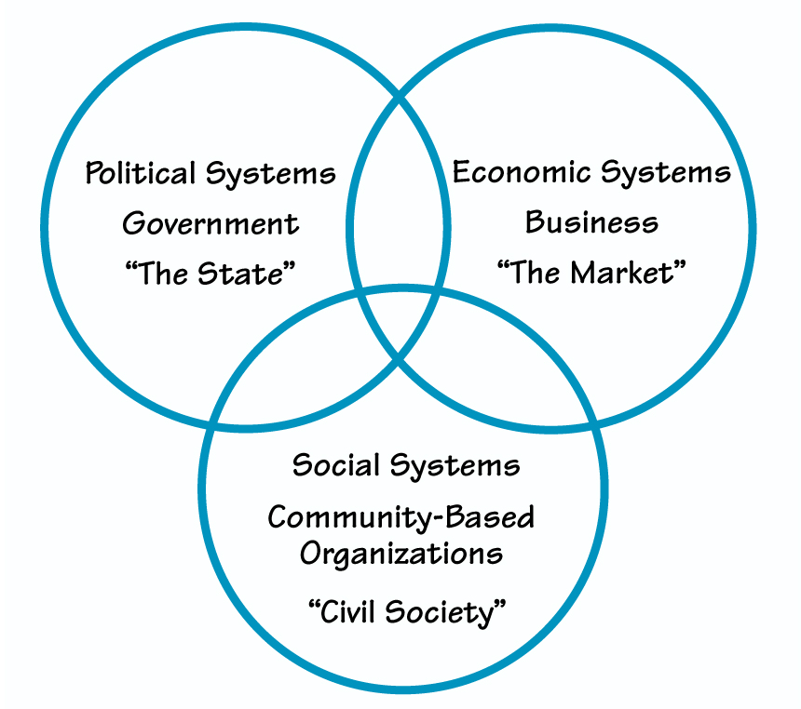
13
All sectors of society can contribute

Slide 20
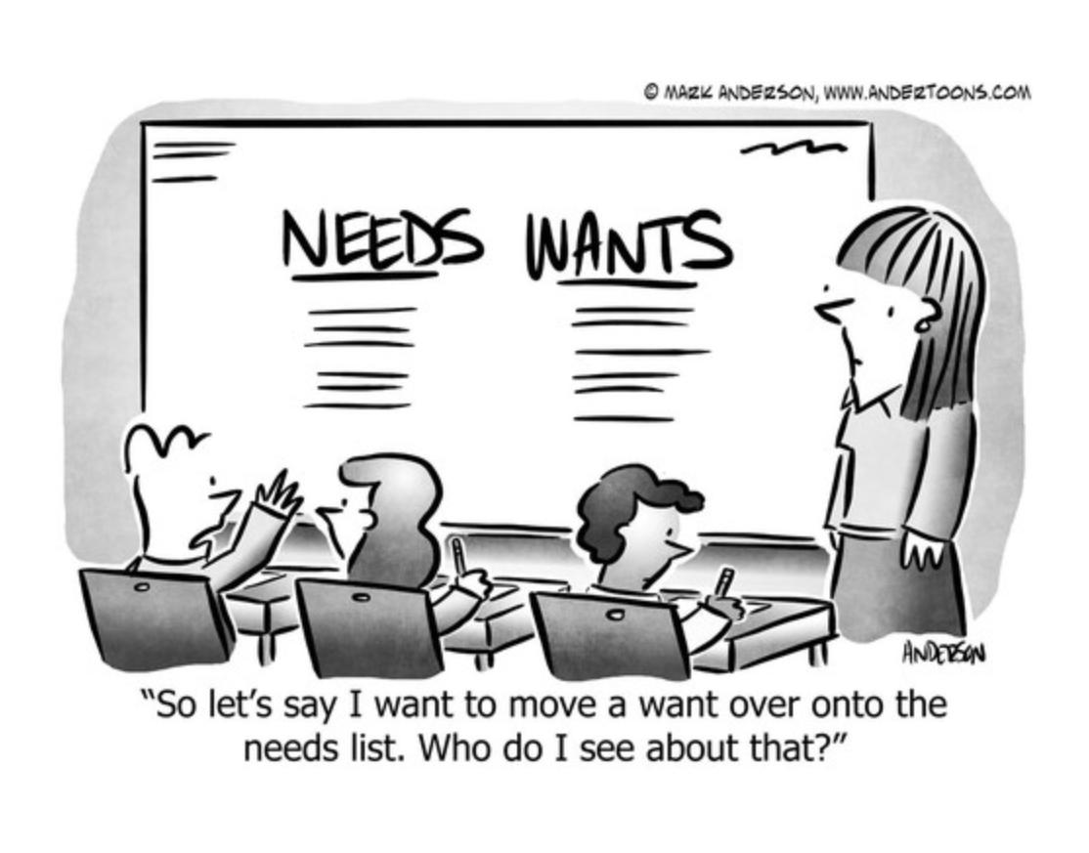
14
Needs and Wants are not the same

Slide 21
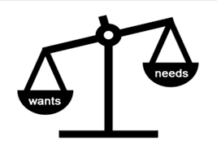
15
Needs tend to be undervalued
in our economy
Wants tend to be overvalued
in our economy

Slide 22
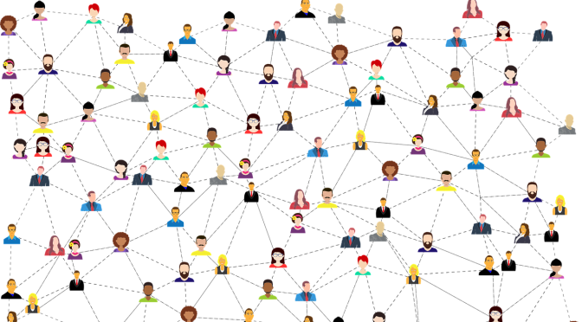
16
Understanding and marshalling social dynamics is critical for success

Slide 23
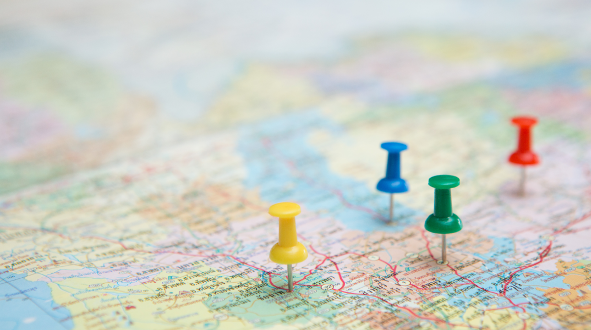
17
To establish trust and effectiveness there needs to be a dialogue between empirical expertise and local cultural experiences

Slide 24
18
To establish trust and effectiveness in any transition – real economic support is essential for those impacted the most

Slide 25
19
Zoom is not the new normal forever. Recognize social needs

Slide 26
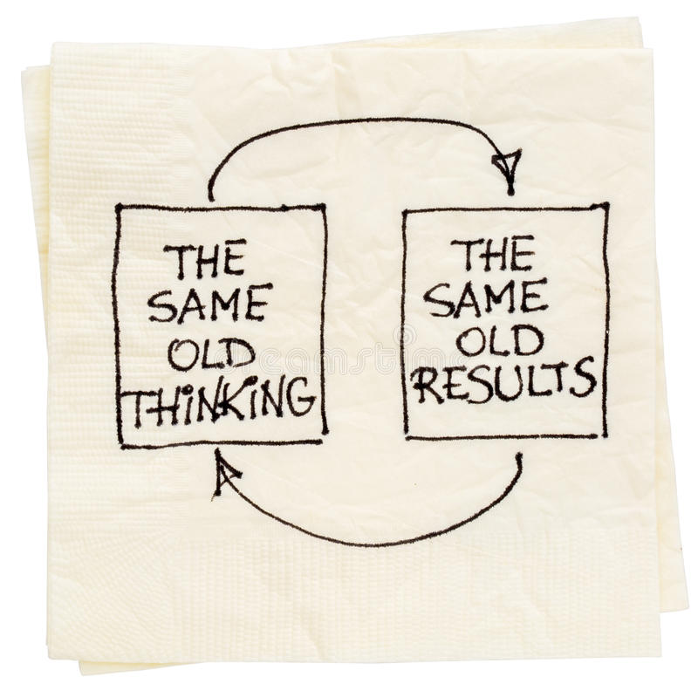
20
If we learn wisdom through the crisis we can come out of this with a better society for all

Slide 27
Dan Joranko
TN Interfaith Power & Light
United Methodist Creation Care
Vanderbilt University
Michael Black
United Methodist EarthKeeper
Georgia State University
Matthew Groves
TN Interfaith Power & Light
Young Evangelicals for Climate Action

Slide 28
facebook.com/TNIPL
tennipl.org

