Slide 1
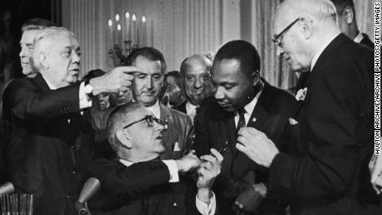
Sometimes We Need a Law
Notes:
Sometimes we need a law. Sometimes the system in place just does not meet the needs of a just society. All the concerned citizens of the 60’s, bundled together, could not give civil rights to black Americans. To do that we needed a law that all had to abide by. We needed a law because the system was broken.

Slide 2
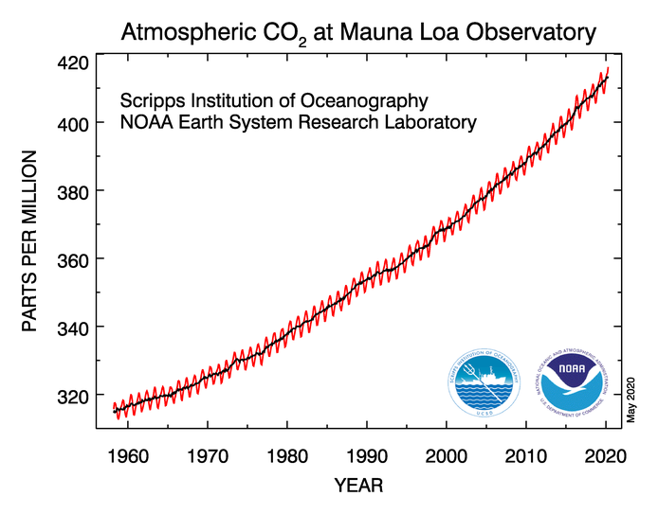
CO2 Levels Hit 415 PPM for First Time in 3 Million+ Years
Notes:
Today we have a broken system also. This is a chart of carbon dioxide concentration in our atmosphere. It is now at 415 parts per million having started at 270 parts per million at the beginning of the Industrial Revolution. It is higher than at any time going back prior to the time our species, homo sapiens, dawned around 200,000 years ago. This is because we dump inordinate quantities of burned fossil fuel, carbon dioxide, into the air. With all the talk about the Climate Crisis, in United States a utility or a corporation can emit unlimited quantities of carbon dioxide into the air with no penalty what so ever.

Slide 3
CO2 and GHG’s Make the Earth Hotter
19 of 20 hottest years occur since 2001
2019 was the second hottest year; 2016 the hottest
A 35 year old has never experienced a month with a cooler average temperature than the average of the twentieth century. (424 months)
2017
1850
Notes:
Note Warming Stripes. Blue and cool in 1850 going to orange and hot in 2017.

Slide 4
These Organizations Say: Climate Change – A Threat to a Livable Earth
National Aeronautics and Space Administration
American Meteorological Society
National Oceanic and Atmospheric Administration
National Academy of Sciences
Notes:
We are on a firm foundation to say climate change is caused by people’s activities. I worked as an engineering intern in the ’60’s for NASA. These organizations have people just like you and I. People that go to work every day dedicated to doing their jobs. They have no hidden agenda to deceive the public. Just the opposite. Take NOAA. They provide the underpinnings for all our hurricane forecasts. We watch and trust what they have to say about these massive atmospheric events. It seems to me we should also trust them when they say climate change due to CO2 concentration in our atmosphere is a big threat to a livable earth.

Slide 5
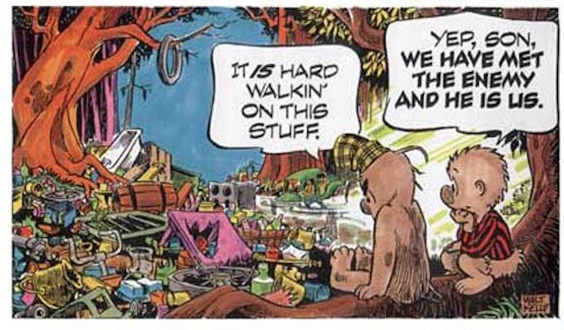
Notes:
Earth Day 1971. At the time trash was a bigger deal than a heating planet. I trust you can see the connection. Porcupine says, “It is hard walkin’ on this stuff.” Pogo poetically responds, “Yep, son, we have met the enemy and he is us.” Us, indeed? U.S.? The United States. Us? Good people trying to do good. Us? Me.

Slide 6
Intergovernmental Panel on Climate Change Special Report – 2018
Capping at 1.5°C
will require a reduction
in global greenhouse gas emissions
to near zero by 2050.
Notes:
How big is the problem? Must act within 10 years. The Fourth National Climate Assessment of the United States in 2018 draws a similar conclusion. Just think for a moment what this means. The change required is not a little bit. It is not a nudge. What would have to change to be near zero?

Slide 7
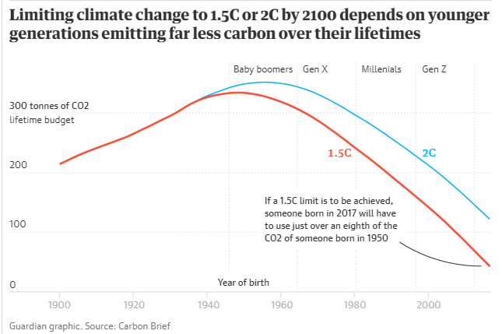
Notes:
Here is another slide demonstrating the same principle. So far we have had little real impact reducing green house gases. CO2 emissions are still going up. Unburned Methane in our atmosphere is still going up. We have to do and about face when it comes to carbon dioxide emissions.

Slide 8
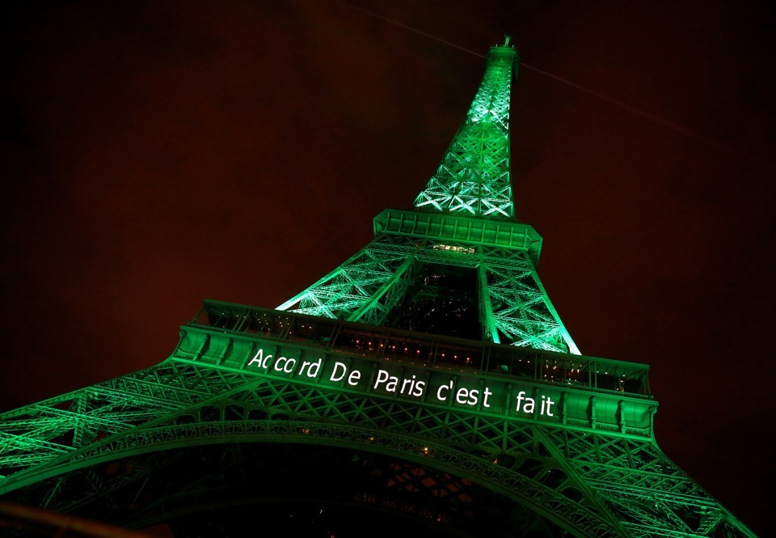
Notes:
Some folks are trying to turn this situation around. And trying mightily. It is not like nothing good is happening. We do have the Paris Agreement of 2015. 195 nations made individual commitments to each other to reduce their carbon emissions. It was a very important step forward. Not a solution, but it was beyond symbolism.

Slide 9
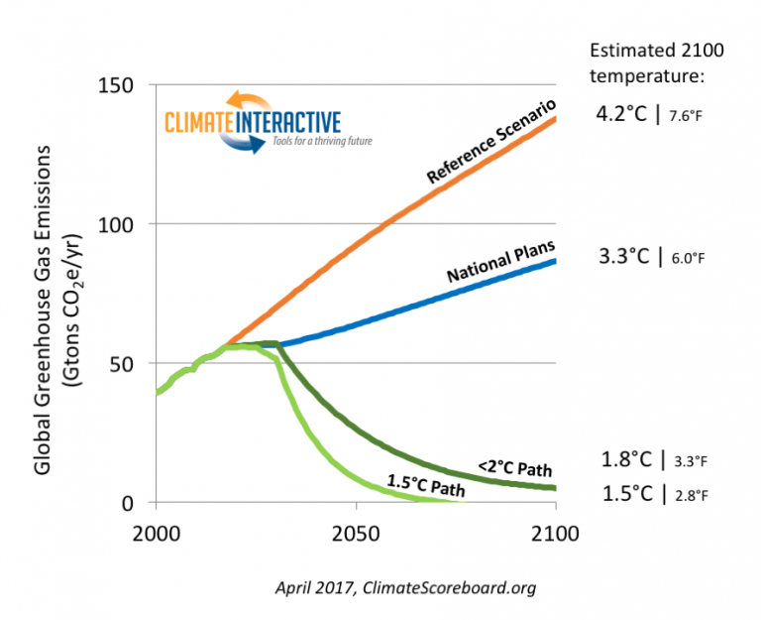
Notes:
The nations of the world were on a path of heating the earth to 4 degrees C or more. The National Plans agreed to in Paris took that down to just above 3 degrees C. Not enough, but a good step toward getting below 2 degrees C and hope was held out to try for 1.5 degrees C maybe at future conferences.

Slide 10
One Nation Declines to Help
Notes:
As we know, one nation has announced its withdrawal. We are currently second in annual CO2 emissions. Of the total unnatural CO2 in our atmosphere, we are responsible for 1/3 of it. Checking out of the Paris Agreement means the US has lost the moral authority to speak or lead. I think most would say leadership by the US must exist to solve the climate crisis. It follows that we must do something important and significant to gain the moral leadership necessary to solve the problem.

Slide 11
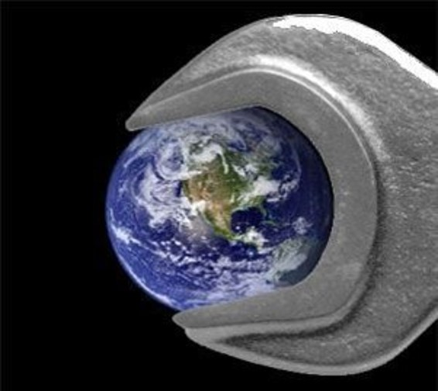
What
Should
We
Do?
Notes:
What should we do?

Slide 12
Our Emissions Harm Our Neighbors
Notes:
Love your neighbor as you love yourself. This commandment is front and center in our Bibles. The second great commandment. The Pacific Islanders are loosing their garden plots to salt water are our neighbors. The folks loosing their homes in northern Alaskan towns due to melting permafrost are our neighbors. The folks fighting and dying in the wildfires of California and Australia are our neighbors. We need a law.

Slide 13
Ministry Table Approves Climate Response
West United Methodist Church will stand in support of legislation and policies that combat climate change and its effects on all creation, advocating specifically for laws and public policies that reduce carbon emissions.
Notes:
Read excerpt

Slide 14
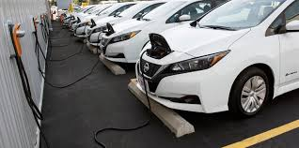
Individual Action We Can Take
Plant Some Trees
Change to LED Lighting
Eat Less Meat
Drive a Hybrid or an Electric Car
Add Solar to Your Home
Recycle/Compost
Local Advocacy - Conservation Day
Conserve Energy at Home
Divest of Fossil Fuel Stock
Notes:
Individual action is good. All reduce greenhouse gases. They help us and our neighbors be mindful of the peril we face. It feels good to do our part. We do need to be mindful it is like training before a marathon. It is good and helpful but it is not the big race that we need to win. We must realize that these actions by concerned citizens bundled together are not enough. Not nearly enough.

Slide 15
“We Need A Law. Stop Carbon Emissions.”
Notes:
To begin to heal the planet we have to stop putting carbon dioxide into the air. There is no work around. There is no alternative. We need a law. The current energy system that depends on fossil fuels does not meet the needs of a just society. All the concerned citizens of the 2020’s, bundled together, can not give a livable planet to our children unless enough of us work on advocacy to pass a law. With all the talk and the known science there has been little visible action by Congress. What is missing?

Slide 16
What Is Missing?
My Kids Are Cooked!
Enough People Who Get It
Notes:
What is missing is enough people educated to the nature and the intensity of the threat.

Slide 17
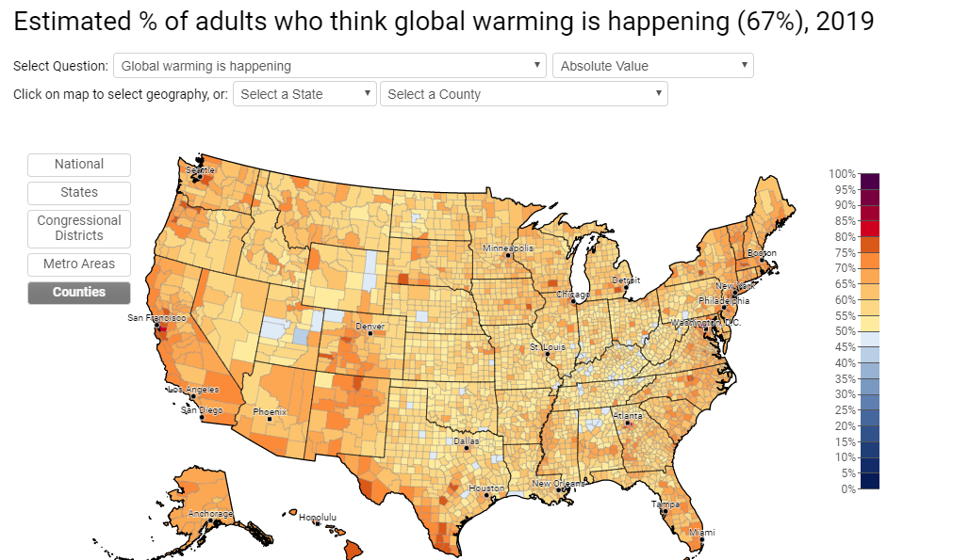
Notes:
Explain Map. Tan greater than 50 %. Blue less than 50%. Essentially every county in America says yes to happening.

Slide 18
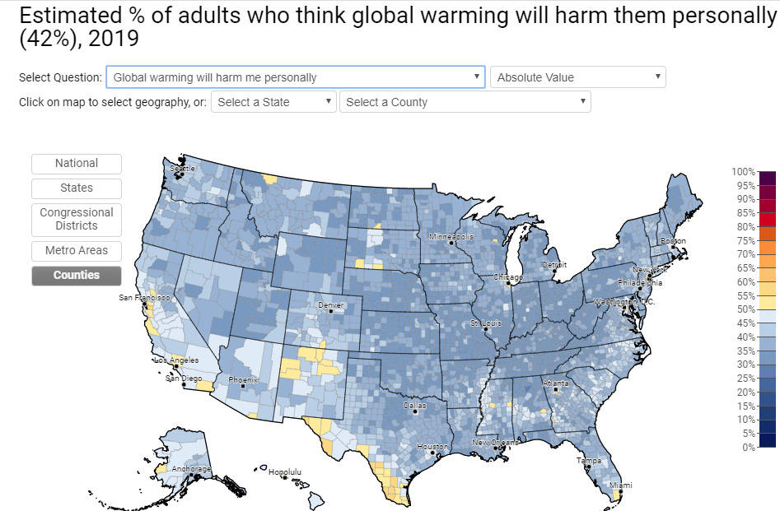
Notes:
Now look at this. Almost every county is blue when asked if global warming will harm me. So the feeling is “It’s happening, but it likely will not harm me.”

Slide 19
What Is Missing?
My Kids Are Cooked!
Enough People Who Get It
Courage to Speak
Political Will to Pass a Law
Notes:
What is missing is enough people educated to the nature and the intensity of the threat. Learning, speaking and passing a law in Congress is the only path that leads to addressing the climate crisis.

Slide 20
Unified Voices in Action – Citizens Climate Lobby
Notes:
Fortunately some people are speaking. . And about the climate crisis. And with a good idea on how to fix it, at least a very big step in that direction. Picture of Citizens Climate Lobby on the Hill a couple years ago.

Slide 21
H.R. 763
Notes:
Generically speaking it is a revenue neutral carbon fee and dividend proposal. It places a price on carbon and returns all money to citizens on an equal person basis.

Slide 22
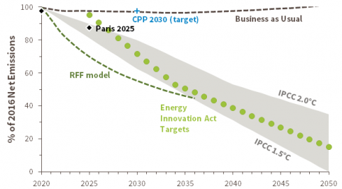
Notes:
Look what happens to CO2 emissions when a price is placed on carbon. Green dots are the H.R. 763 legislative emission targets established in law. Price adjustments are made if needed by law to bring emissions on target. RFF, Resources for the Future Model, is a third party group that does economic analysis. RFF’s dotted line says they expect better performance than the legislation requires.

Slide 23
A Strong Economy While Fixing Climate Change
Employment
2.1 Million More Jobs
Humanity
Saves 295,000 Lives
Climate
CO2 Down 90% by 2050
Economy
$3400/Year for a Family of Four
Energy
Moving Toward Independence Wars”
10 Year Projections
Notes:
Nonpartisan third party economic studies show there is no legitimate economic reason against addressing climate change. This is all happening in the house. There are presently 81 members of the House cosponsoring the bill. 218 votes required to pass.

Slide 24
Economist Support a Carbon Tax
Most cost effective. Invisible hand steers toward low-carbon economy
Carbon price should steadily increase thereby encouraging technology and large-scale infrastructure
A robust carbon price will replace the need for regulation
To protect U.S. competitiveness include a border adjustment. Provides incentive for other nations to price carbon.
To maintain fairness, return all the money to American people. Most Americans will receive more dividends than paid in higher energy costs
Notes:
All living past chairpersons of the Federal Reserve - Janet Yellen, Ben Bernanke, Alan Greenspan, Paul Volcker say put a price on carbon and return the money to the American people. Wow how much more economic support does one need to have confidence that pricing carbon will work?

Slide 25
No Price on Carbon Dioxide
Notes:
This map by University of Texas, Austin (July, 20126) shows by county the least expensive system to provide energy by county if a new investment were made today. Wind is green. Solar Photo Voltaic is purple or gray. Natural Gas is tan. This map is for no price on carbon emissions.

Slide 26
$50/Ton Price on Carbon Dioxide
Notes:
Now $50/ton. Around year five under H.R. 763. Wind grows in the plains states. The southwest is all solar photovoltaic. The southeast has much more solar photo voltaic with less natural gas.

Slide 27
$100/Ton Price on Carbon Dioxide
Notes:
Now $100/ton. Almost all of the US, for new investment, the least expensive option to deliver a watt of power is wind or solar photovoltaic. Pricing carbon as HR 763 does will change the investments utilities make and will eliminate carbon as a fuel.

Slide 28
There Is No Moral Middle Ground
Notes:
No action or inaction leads to the pictures like this one and worse. Our advocacy efforts are needed to stop this crisis. Our history tells us focused action is possible. Consider WWII, Civil Rights Act, or the Moon Landing. Or indeed the covid 19 virus. Americans have largely acted together and Congress has authorized huge amounts of money in only days.

Slide 29
We Can Still Make a Safe Handoff, If….
Notes:
We can still make a safe handoff to the next generation… IF

Slide 30
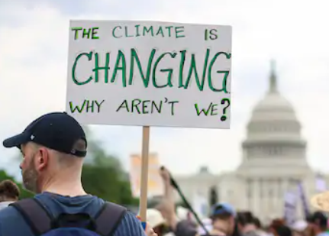
If there exists…
I Voting to
Save My Kids
More People Who Get It
Courage to Speak
Members of Congress, A President, Who Will Vote a Bill, into Law
HR 763
Notes:
Our voice matters. Our vote in 2020 matters.

Slide 31
House Bill H. R. 763 80 Democratic and 1 Republican sponsors
Carbon price at $15/ton CO2 equivalent
Increases $10/ton each year
All net revenue allocated as a monthly dividend.
There is a border adjustment.
The target is 90% reduction by 2050.
H.R. 763
Notes:
It comes very close to the zero emissions required by the IPCC to be near zero by 2050.

Slide 32
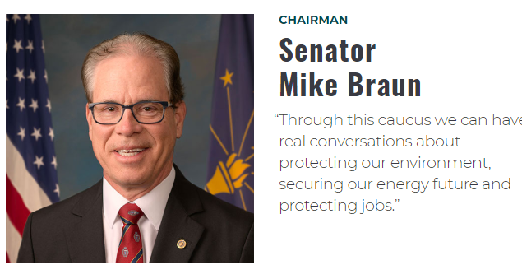
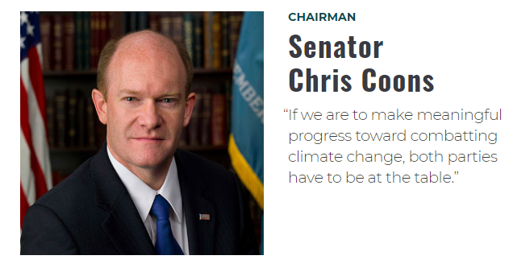
Notes:
The activity in the Senate is the climate solutions caucus. There are 14 members. Half Republican; half Democrat. They are holding hearings.
There is also a good bill in the Senate. Climate Action Rebate Act. S. 2284. So there is activity in both houses of Congress even though no interest, just the opposite, is being expressed by the current President.

Slide 33
sapiens
Notes:
Today we have a broken system also. This is a chart of carbon dioxide concentration in our atmosphere. It is now over 400 parts per million having started at 270 parts per million at the beginning of the Industrial Revolution. It is higher than at any time going back prior to the time our species, homo sapiens, dawned. This is because we dump inordinate quantities of burned fossil fuel, carbon dioxide, into the air. With all the talk about the Climate Crisis, in United States a utility or a corporation can emit unlimited quantities of carbon dioxide into the air with no penalty what so ever.

Slide 34
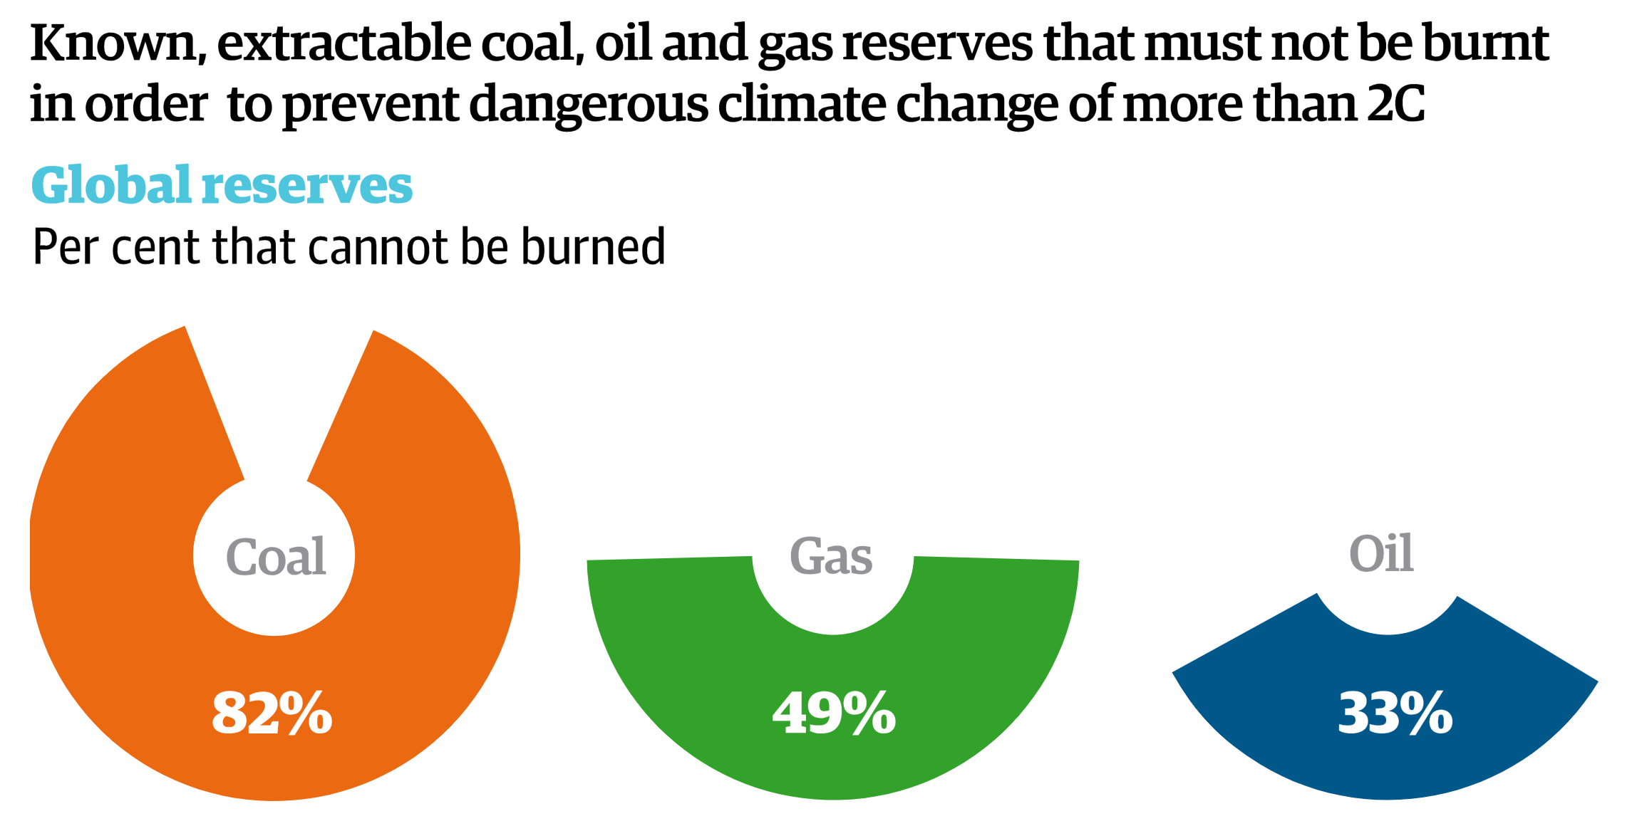
Carbon we must NOT burn to stay below 2 degrees
The Guardian
Notes:
Look at all the known carbon we cannot burn to have a chance to protect a livable planet. SLIDE. Think about all those who have a vested interest in keeping things as they are. I think more good people will need to engage to overcome those wishing to develop these fossil fuel reserves to be later burned into carbon dioxide.

